Slide 1

Welcome!
Grab a drink, food, and chat with your fellow makers.
April 25, 2017

Slide 2

What is Open Hardware?
Open (Source) Hardware, or OSHW, is “hardware whose design is made publicly available so that anyone can study, modify, distribute, make, and sell the design or hardware based on that design.”

Slide 3
Introductions
Name
Day Job or other
Open / Hardware Experience
What’s your Current / Next Project?

Slide 4

Presentation:

Slide 5
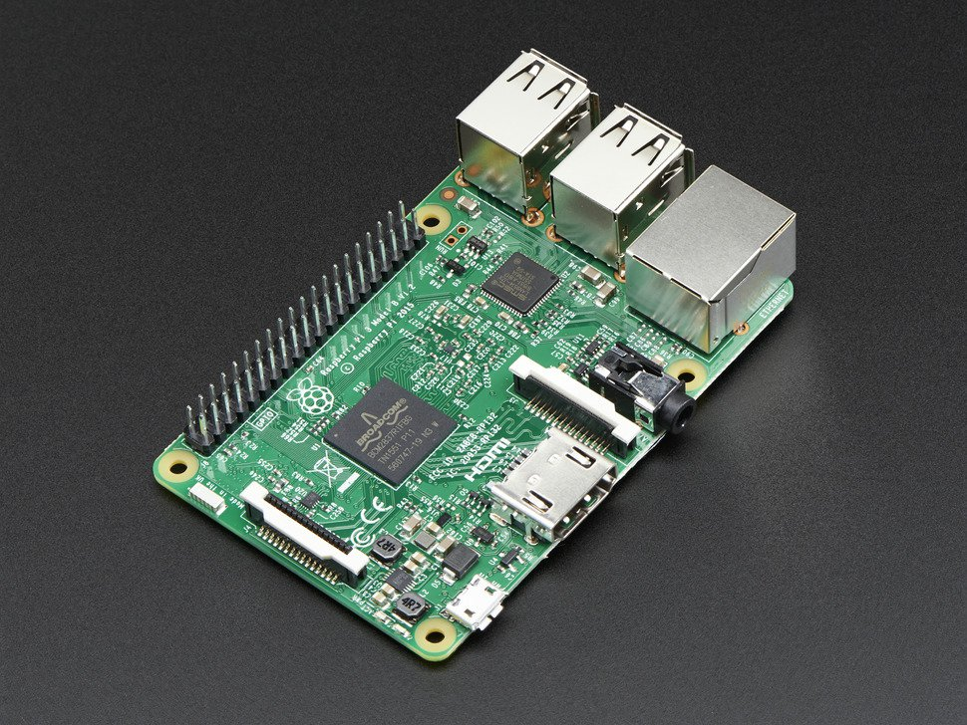
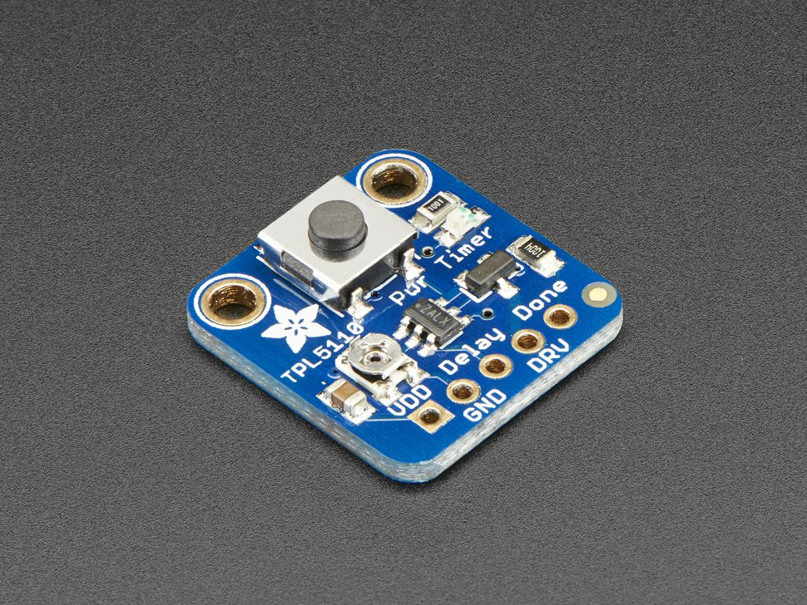
Power management for Raspberry Pi
Adafruit TPL5110 Low Power Timer Breakout

Slide 6
RPi Power Management: Goals
Cheap: <$10
Simple: <10 components
Quick: Parts USA sourced
Easy: Leverage existing libraries

Slide 7
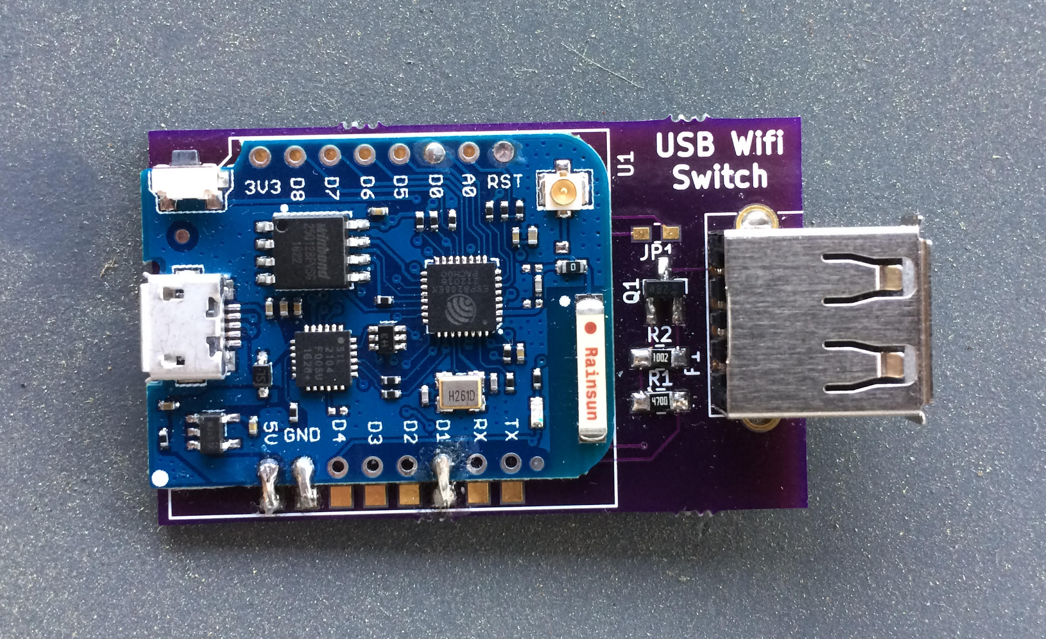
USB Wifi Switch:

Slide 8
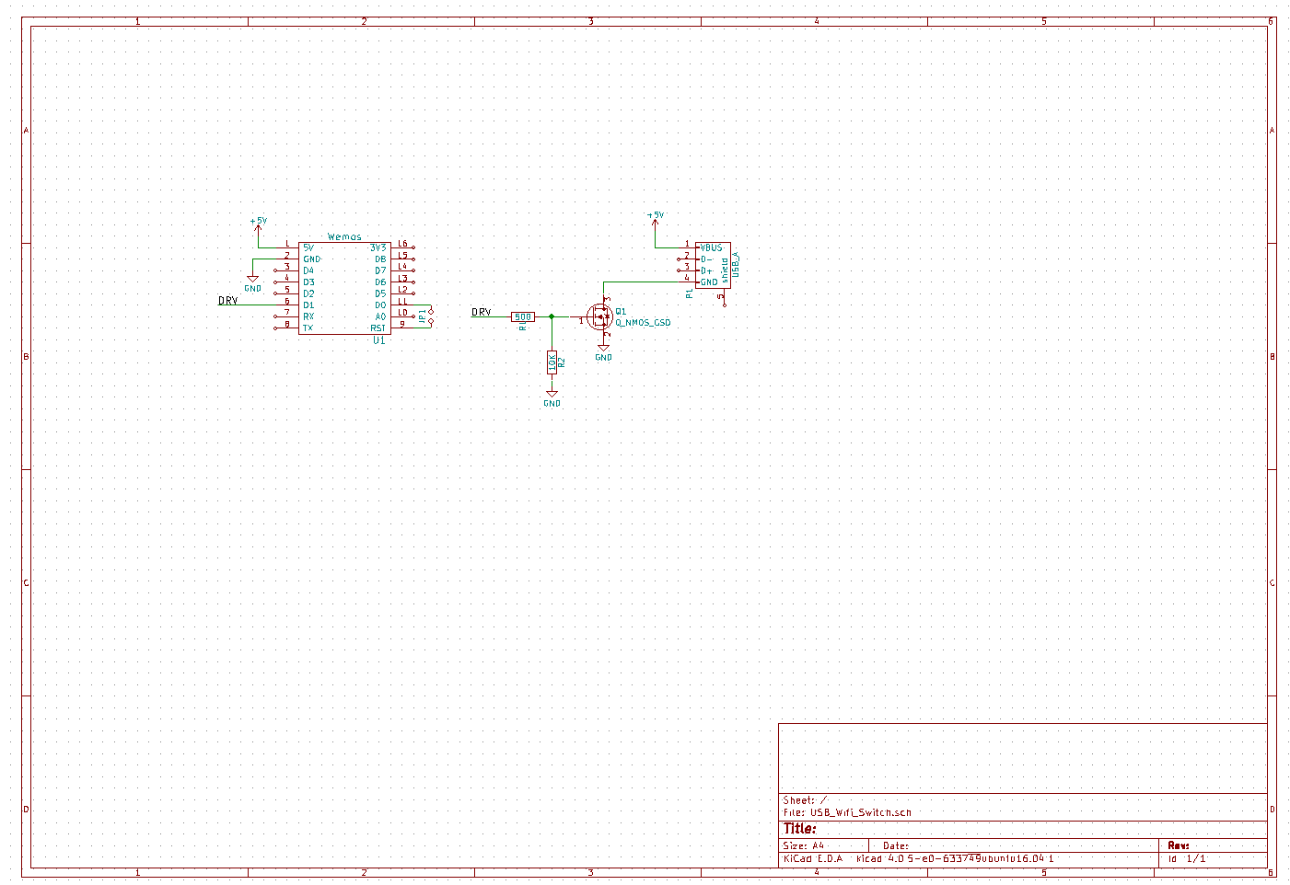
Schematic:

Slide 9
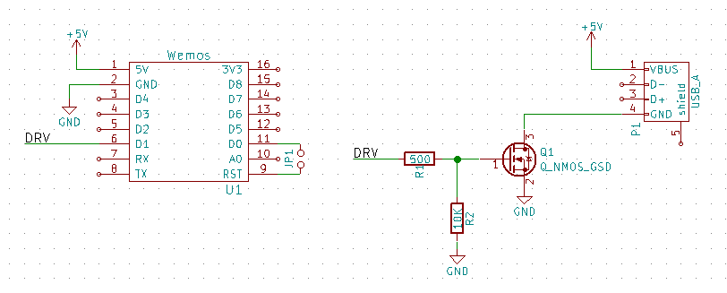
Schematic:

Slide 10
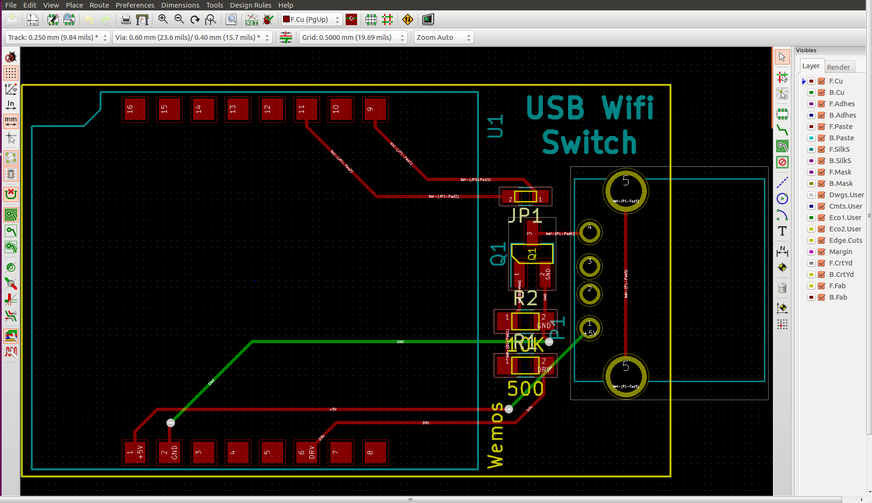
PCB Layout:

Slide 11
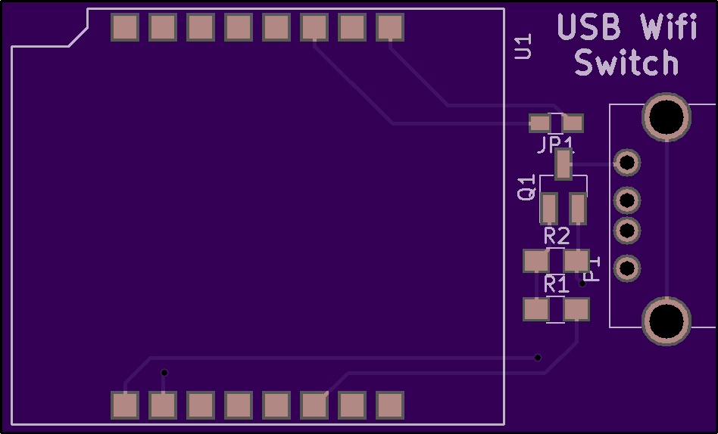

OSH Park Board:

Slide 12
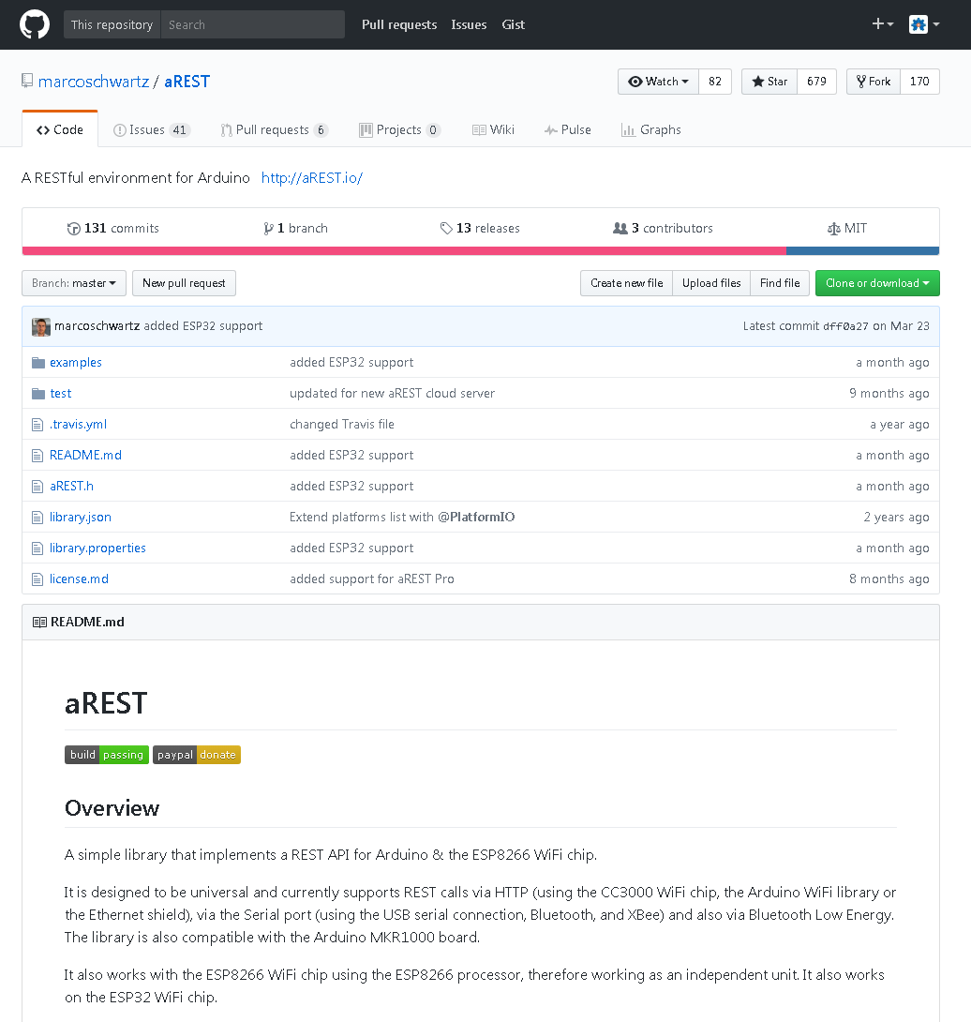
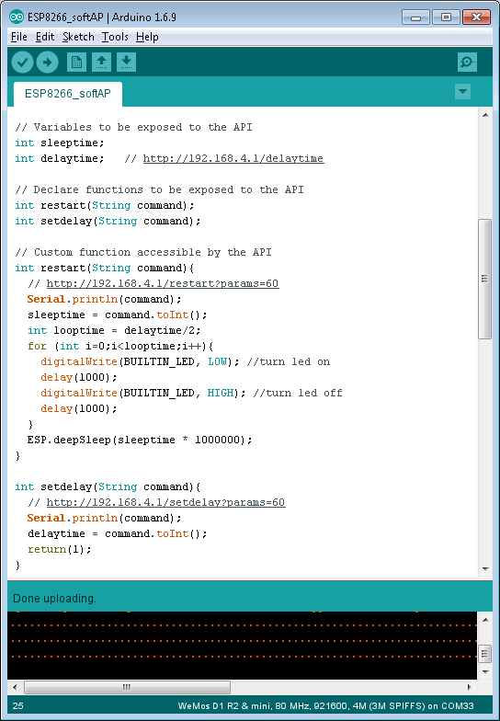
Arduino Code:

Slide 13
Raspberry Pi Manual Operation:
Connect wifi to SSID: USBWifiSwitch PW:12345678
In terminal:
curl http://192.168.4.1/setdelay?params=20
curl http://192.168.4.1/delaytime
curl http://192.168.4.1/restart?params=60

Slide 14
Raspberry Pi Script:
Not done yet.

Slide 15
Results:
Current Draw | Standard | PowerSave
On | 0.27 A | 0.37 A
Off | 0.09 A | 0.00015 A
Ave Current | 50% | 25% | 10% | 1%
Standard | 0.18 A | 0.135 A | 0.108 A | 0.0918 A
PowerSave | 0.185 A | 0.0926 A | 0.0371 A | 0.00385 A
 | 102.8% | 68.6% | 34.4% | 4.2%

Slide 16
Live Demo:

Slide 17

indyopenhardware@gmail.com
@INOpenHardware
indy-ansible-invite.herokuapp.com/she4ytoexq2uiapnsa0x
meetup.com/Indy-Open-Hardware-Meetup github.com/IndyOpenHardware

Slide 18
Project presentations:
Ground rules:
No “Um, actually…”
No ‘Mock Surprise’
Money talk not required
Be ok with “I’ll get to that”

